Slide 1
LAMP
Linux, Apache, MySQL, and PHP

Slide 2
L.A.M.P.
Web application stack made up of freely available, open source products
Linux (but there are distributions for most OSes)
Apache Web Server
MySQL Database Server
PHP Hypertext Preprocessor (a web scripting language that runs in Apache)
LAMP, WAMP, MAMP, SAMP, FAMP

Slide 3
Apache Web Server
The most popular web server on the planet
~45% global market share as of January 2017 https://news.netcraft.com/archives/2017/02/27/february-2017-web-server-survey.html
Tried, true, and venerable – Apache has been around since 1995
Used by wikipedia, Apple and many others
In 1999 the Apache Software Foundation was launched to support the Apache HTTP Server and other software development
http://httpd.apache.org/
Notes:
https://news.netcraft.com/archives/2017/02/27/february-2017-web-server-survey.html

Slide 4
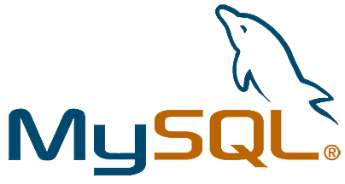

A powerful, flexible, and stable RDBMS
MariaDB is an open source version of MySQL – More later
Popular amongst open source developers – also venerable, MySQL dates back to 1995
Owned by Oracle since its acquisition of Sun Microsystems in January 2010 (who bought it in 2008)
Another excellent option is PostgreSQL (LAPP...)
http://www.mysql.com/

Slide 5
PHP
Server side scripting language for the web
runs as a standard Apache module
PHP Hypertext Preprocessor
originally, "Personal Home Page"
Interpreted, not compiled ahead of time (though it can be)
First release in (you guessed it) 1995
http://www.php.net/

Slide 6

Possible AMP Configuration...
Machine 1
Machine 2
php
port 3306
MySQL Server
Apache Web Server

Slide 7
Your AMP Configuration
Your Machine
php
port 3306
MySQL Server
Apache Web Server

Slide 8
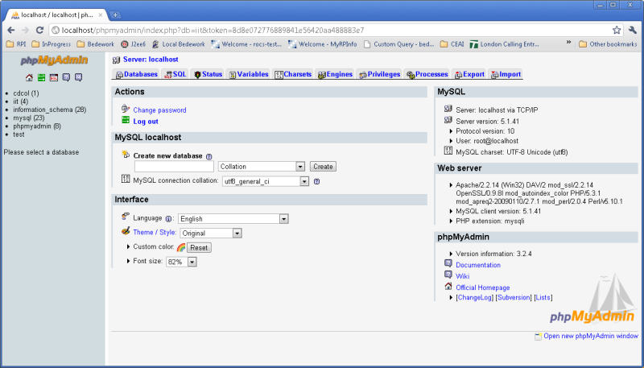
phpMyAdmin

Slide 9
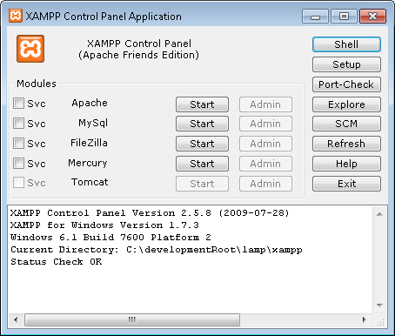
XAMPP
A LAMP / WAMP / MAMP stack

Slide 10
Running Apache and MySQL
Start up the XAMPP Control Panel
Start Apache
Start MySQL/MariaDB
You now have full featured web and database servers running on your laptops.
Let's take a quick look around.

